Slide 1
How to be a web developer ?
KHALIL mALLEK

Slide 2
Plan
Introduction
How does the web works?
What do you need to be a web developer?
What’s the role of a web developer?
Conclusion

Slide 3
Introduction
This presentation is my first one in the academy “GOMYCODE”.
give and explain three important definitions:
The work manner of the web
The needs of a developer
The role of a developer

Slide 4
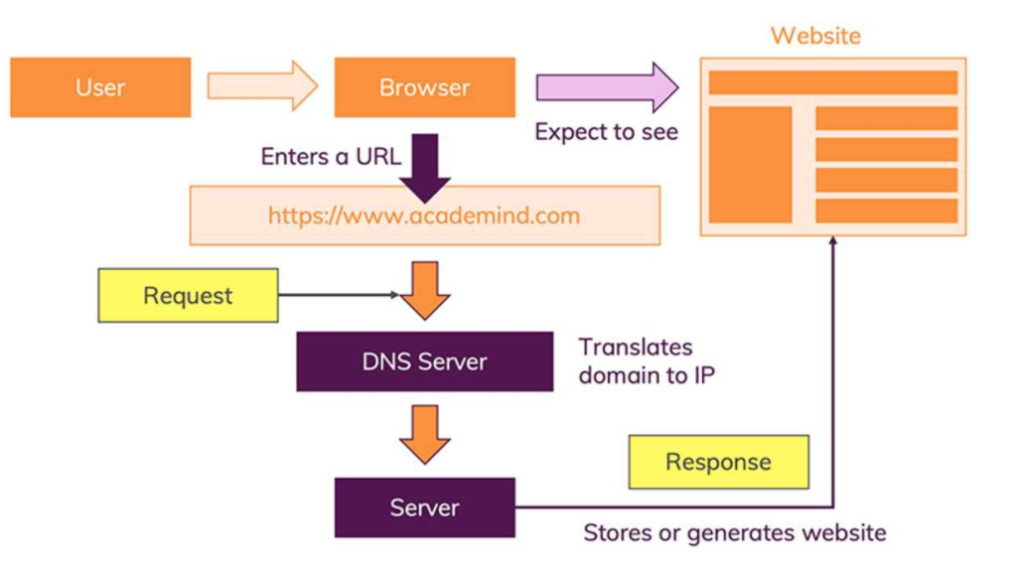
How does the web works?
The URL gets resolved
A Request is sent to the server of the website
The response of the server is parsed
The page is rendered and displayed
https://gomycode.com/TN-FR/home

Slide 5
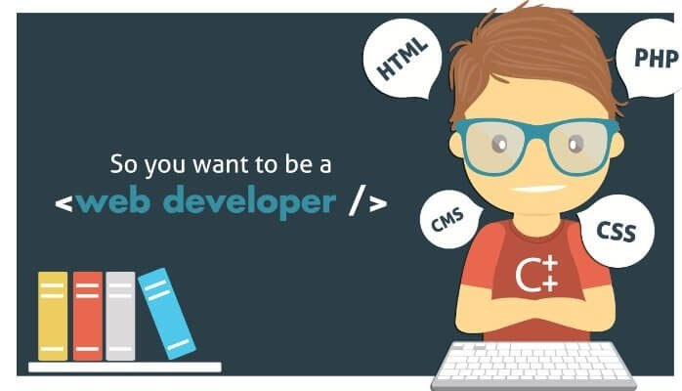
what do you need to be a web developer?
User experience (UX)
User interface (UI)
Coding languages including HTML and CSS
Frontend web programing languages and skills such as JavaScript, Ajax and Web animation techniques
Backend web programing languages such as C# or Java, PHP and Ruby.

Slide 6
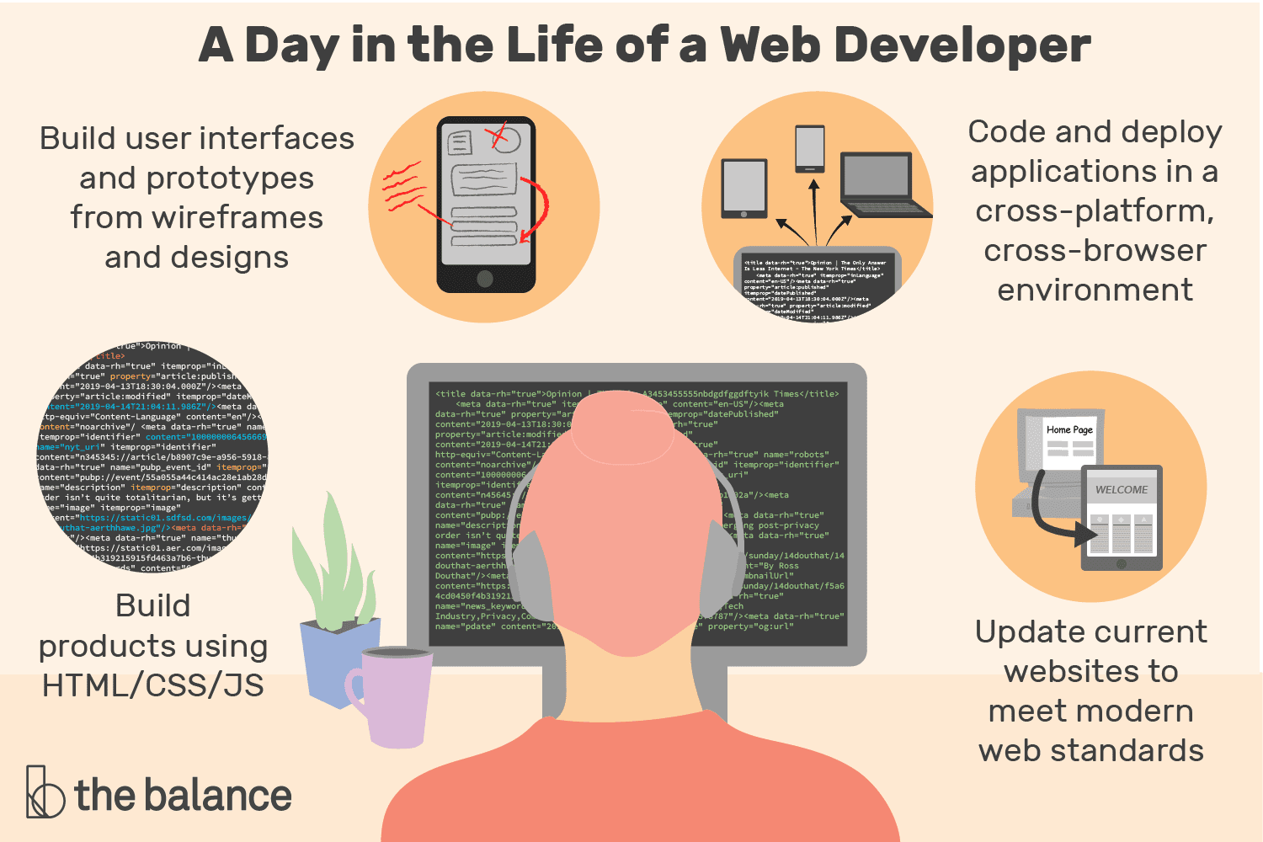
What’s the role of a web developer?
A Web Developer is responsible for the coding, design and layout of a website according to a company's specifications
A certain level of both graphic design and computer programming is necessary

Slide 7
Conclusion
The web coding is the essential step to build a website
This step is done by a developer who must have many skills like,,,

Slide 8
Thank you for your attention

